Slide 1
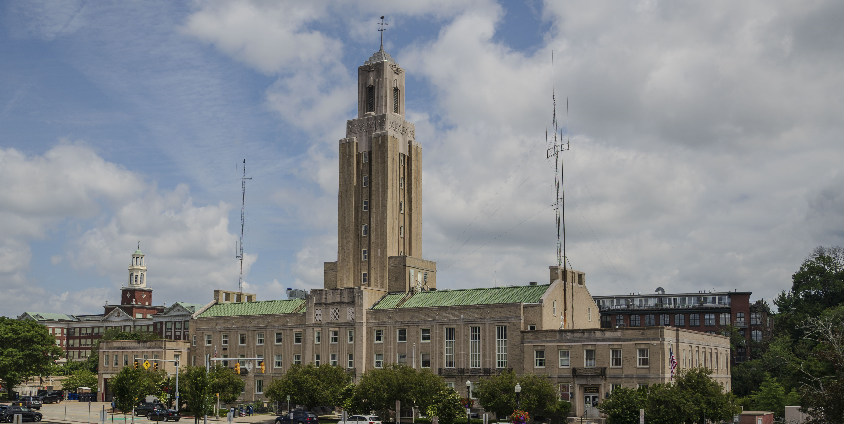

HOME-ARP Program Overview
August/September 2025

Slide 2
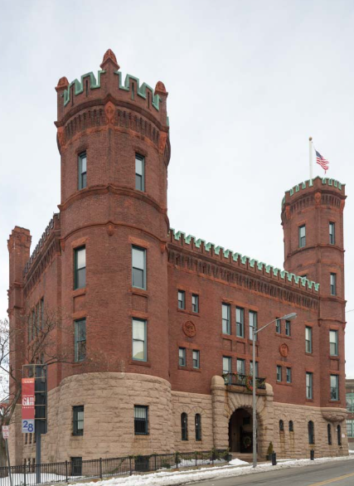
▹ Overview of Funding
▹ Qualifying Populations
▹ Eligible Uses
▹ Identify Priority Needs/Gaps for Special Populations
▹ Learn What Programs/Projects are
Currently in Development

Slide 3
City's allocation:
$2.1 Million
This is one-time, time-limited funding
Must be expended by September 2030
American Rescue Plan (ARP) provides $5 billion for homelessness assistance and assistance to other vulnerable populations to:
▹Provide capital investment for
permanent rental housing;
▹Upgrade available stock of shelter to
include non-congregate shelter; and
▹Provide tenant-based rental assistance
and supportive services.

Slide 4
 | Funding Amount | Percent of the Grant | Statutory Limit
Supportive Services | $ 154,000
Acquisition and Development of Non-Congregate Shelters | $ 353,500
Tenant Based Rental Assistance (TBRA) | $ -0-
Development of Affordable Rental Housing | $1,000,000
Non-Profit Operating | $ 103,803 | 5 % | 5%
Non-Profit Capacity Building | $ 103,803 | 5 % | 5%
Administration and Planning | $ 311,489 | 15 % | 15%
Total HOME ARP Allocation | $2,076,595
The City of Pawtucket began its consultation process in February 2022. The City identified the local and regional agencies that met the requirements of the HOME-ARP notice for consultation and contacted these agencies via email to schedule the consultations. Consultations occurred via a mixture of in-person meetings, telephone meetings, and video conferences during February through April 2022.

Slide 5


QUALIFYING POPULATIONS
Homeless
(McKinney-Vento
definition)
At-risk of homelessness
(McKinney-Vento
definition)
Fleeing/attempting to flee:
Domestic violence
Dating violence
Sexual violence
Trafficking
Other populations
for whom supportive services would prevent homelessness or serve those at greatest risk of housing instability.
Veterans and families with a veteran member
that meet one of the other criteria.
See HOME-ARP CPD Notice 21.10: https://www.hud.gov/sites/dfiles/OCHCO/documents/2021-10cpdn.pdf.

Slide 6

Homeless Definition:
QUALIFYING POPULATIONS
An individual or family who lacks a fixed, regular, and adequate nighttime residence.
▹ An individual or family who will imminently lose their primary nighttime residence and meet the criteria noted at 24 CFR 91.5.
▹ Unaccompanied youth under 25 years of age, or families with children and youth who would not otherwise qualify under the criteria above but meet the definition of homeless under other federal statutes as identified in 24 CFR 91.5.

Slide 7

At-Risk of Homelessness Definition:
QUALIFYING POPULATIONS
An individual or family who:
1.
Is extremely low-income
(under 30% AMI)
2.
And does not have support networks
to prevent them from moving into shelter
3.
And meets one of the following conditions:
(next slide)

Slide 8
At-Risk of Homelessness Definition:
QUALIFYING POPULATIONS
▹ Has moved because of economic reasons two or more times during the 60 days immediately preceding the application for homelessness prevention assistance;
▹ Is living in the home of another because of economic hardship;
▹
Has been notified in writing that their right to occupy their current housing or living situation will be terminated within 21 days after the date of application for assistance;
▹ Lives in a hotel or motel and the cost of the hotel or motel stay is not paid by charitable organizations or by federal, State, or local government programs for low-income individuals;
▹ Lives in a single-room occupancy or efficiency apartment unit in which there reside more than two persons or lives in a larger housing unit in which there reside more than 1.5 people per room, as defined by the U.S. Census Bureau;
▹ Is exiting a publicly funded institution, or system of care (such as a health-care facility, a mental health facility, foster care, etc.)

Slide 9

Domestic Violence, Dating Violence, Sexual Violence, Stalking or Human Trafficking Definition (24 CFR 5.2003):
QUALIFYING POPULATIONS
An individual or family who:
1. Is fleeing, or is attempting to flee domestic violence, dating violence, sexual assault,
stalking, or other dangerous or life-threatening conditions that relate to violence
against the individual or a family member.*
2. Is fleeing, or is attempting to flee, human trafficking, including sex trafficking and
labor trafficking.
*Including a child, that has either taken place within the individual's or family's primary nighttime residence or has made the individual or family afraid to return to their primary nighttime residence.

Slide 10

Other Populations: Requiring service or housing assistance to
prevent homelessness
QUALIFYING POPULATIONS
Households (either individuals and families):
Who have previously been qualified as “homeless” as defined in 24 CFR 91.5.
Are currently housed due to temporary or emergency assistance.*
Who need additional housing assistance or supportive services to avoid a return to homelessness.
*Including financial assistance, services, temporary rental assistance, or some type of other assistance to allow the household to be housed.

Slide 11


OTHER POPULATIONS: At Greatest Risk of Housing Instability
QUALIFYING POPULATIONS
Households (either individuals and families):
Annual income is ≤30% AMI
are experiencing severe cost burden.
(i.e., is paying more than 50% of monthly household income toward housing costs)
Annual income is ≤ 50% AMI
and meets one of the conditions in paragraph (iii) of “At risk of homelessness” definition at §91.5.
OR

Slide 12
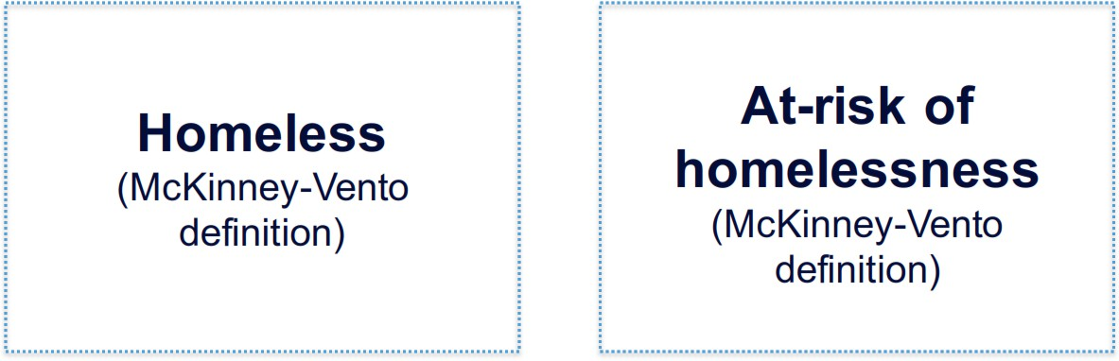
QP PREFERENCES

Slide 13
HOME-ARP funds can be used for these eligible activities:
ELIGIBLE USES
Administration and
Planning
Production or Preservation of Affordable Housing
Tenant-Based Rental Assistance (TBRA)
Non-Profit Operating
and
Non-Profit Capacity Building
Purchase and/or Development of Non-Congregate Shelter
Supportive Services, Homeless Prevention Services, and Housing Counseling

Slide 14
HOME-ARP funds can be used for these eligible activities:
ELIGIBLE USES
Administration and
Planning
Production or Preservation of Affordable Housing
Tenant-Based Rental Assistance (TBRA)
Non-Profit Operating
and
Non-Profit Capacity Building
Purchase and/or Development of Non-Congregate Shelter
Supportive Services, Homeless Prevention Services, and Housing Counseling

Slide 15

Planning and Administration
ELIGIBLE USES
The City of Pawtucket has chosen to allocate the full allowable amount (15% of the total grant) toward planning and administration costs.

Slide 16
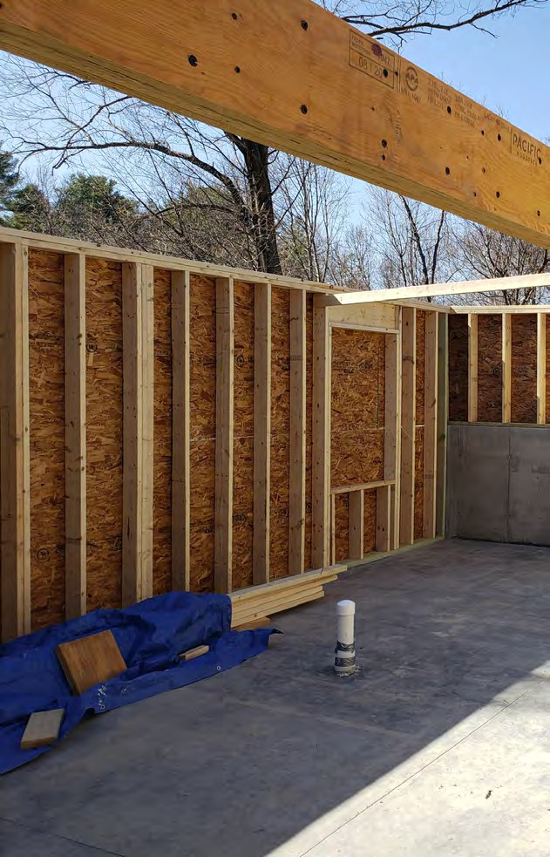
ELIGIBLE USES
PRODUCTION / PRESERVATION OF
AFFORDABLE HOUSING
▹ Construction of new rental housing units;
▹
Acquisition of existing housing units;
▹ Re-investment of existing affordable housing with the goal of serving lower incomes.

Slide 17
Acquisition/Development of Non-Congregate Shelter (NCS)
ELIGIBLE USES
One or more buildings that provide private units or rooms for temporary shelter
May include the construction of new structures or the acquisition and/or rehabilitation of existing structures (such as motels, nursing homes, or other facilities) to be for use as HOME-ARP NCS
NCS projects must comply with HOME-ARP requirements during the restricted use period established in the HOME-ARP Notice.
New Construction: 15 years
Rehabilitation: 10 years
Acquisition Only: 10 years

Slide 18
Non-Profit Operating Expenses
ELIGIBLE USES
In service of Qualifying Populations.
Funds may be used for general administrative and operational costs not tied to a specific project, such as Salaries, Rent, Insurance, etc.
The amount of funds available for non-profit capacity building is capped at 5% of the total grant award.

Slide 19
Non-Profit Capacity Building
ELIGIBLE USES
In service of Qualifying Populations.
Intended to enhance the reach, capability, or efficiency of a service organization.
The amount of funds available for non-profit capacity building is capped at 5% of the total grant award.

Slide 20
ELIGIBLE USES
Tenant Based Rental Assistance (TBRA)
The City of Pawtucket has chosen not to fund activities under the Tenant Based Rental Assistance category.

Slide 21

ELIGIBLE USES
Supportive Services in compliance with the following:
1. Qualifying individuals or families
2. Separate activity or in combination with other HOME-ARP activities.
3. Not already receiving these services through another program.
There are three categories of eligible supportive services under HOME-ARP:
▹ McKinney-Vento (homeless at initial intake)
▹ Homelessness Prevention
▹ Housing Counseling
(as defined at 24 CFR 5.100 and 5.111)

Slide 22

ELIGIBLE USES
MCKINNEY-VENTO SUPPORTIVE SERVICES
▹ Childcare
▹ Education Services
▹ Employment Assistance & Job Training
▹ Food
▹ Housing Search & Counseling Services
▹ Legal Services
▹ Life Skills Training
▹ Mental Health Services
▹ Outpatient Health Services
▹ Outreach Services
▹ Substance Abuse Treatment Services
▹ Transportation
▹ Case Management
▹ Mediation
▹ Credit Repair
▹ Landlord/Tenant Liaison
▹ Financial Assistance Costs

Slide 23

ELIGIBLE USES
HOUSING COUNSELING ELIGIBLE COSTS:
Staff salaries and overhead costs of HUD-certified housing counseling agencies related to directly providing eligible housing counseling services to HOME program participants
Development of a housing counseling work plan
Marketing and outreach
Financial and housing affordability analysis
Action plans that outline what the housing counseling agency and the client will do to meet the client's housing goals and that address the client's housing problem(s)
Follow-up communication with program participants

Slide 24
ELIGIBLE USES
Deadlines
August 27, 2025 Publish NOFO and open applications
September 4, 2025, 5:00 PM HOME-ARP optional informational workshop. 100 Freight Street, Pawtucket, RI.
September 17, 2025 Deadline to send “intent to apply” email
  Applicants must submit a brief project description including organization name, eligible project type, project location, and number of proposed units or clients served, as applicable.
September 29, 2025 Application closes at 4:00 pm EST. No more applications will be accepted after this time.

Slide 25
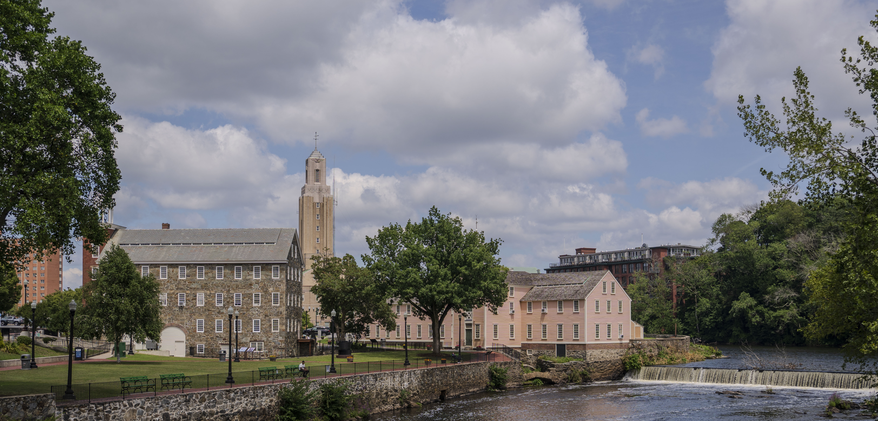
Contact Information
Mark E. Goudreau
Community Development Program Manager
City of Pawtucket
mgoudreau@pawtucketri.gov

