Slide 1


NEIGHBORHOOD
PARKING
MEETING
March 20, 2025

Slide 2

INTRODUCTION
MAYOR DONALD R. GREBIEN AND
COUNCILOR NEICY CODERRE

Slide 3
STADIUM
PARKING PLAN

Slide 4
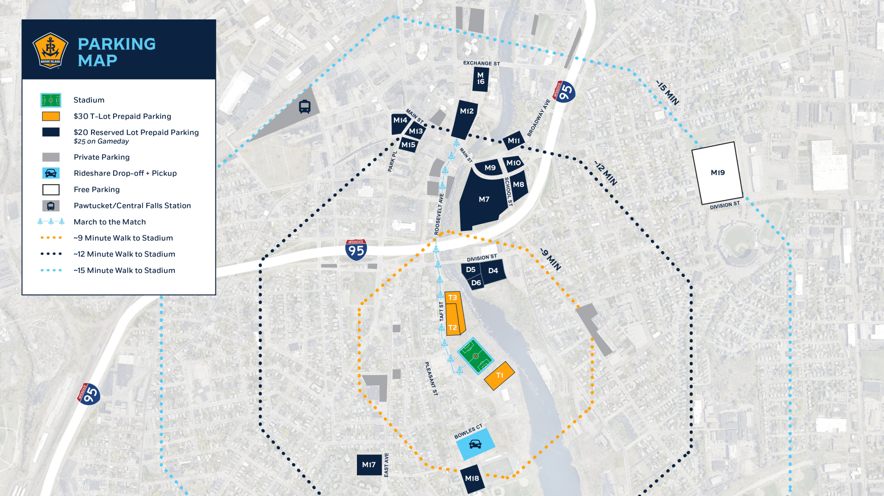

Slide 5
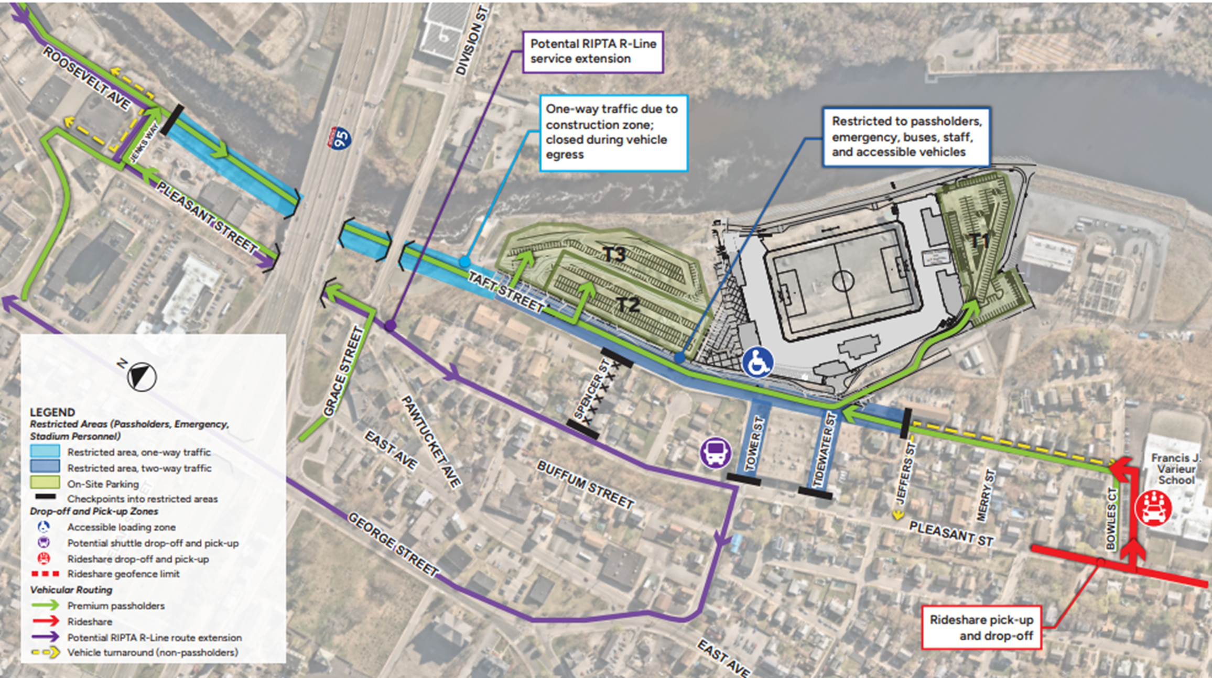

Slide 6
RESIDENT PARKING PERMITS

Slide 7
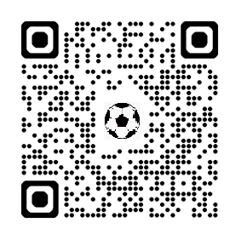
RESIDENT PARKING INFO:
  The proposed ordinance is in front of the City Council.
  Residents would apply for parking permits via the City Clerk's Office in person or by email stadiumzone@pawtucketri.gov
  Only eligible for residents in designated stadium zone.
    Resident parking would be enforced during home games and other stadium events.
    Resident parking stickers and guest permits would expire every two years.
  Maximum fine of $500 for violations.
    Fines start at $100 and would double if unpaid after 14 days and triple after 28 days.
  Selling, leasing, or duplicating permits is illegal.
SCHEDULE OF GAMES/EVENTS
https://www.rhodeislandfc.com/schedule/

Slide 8
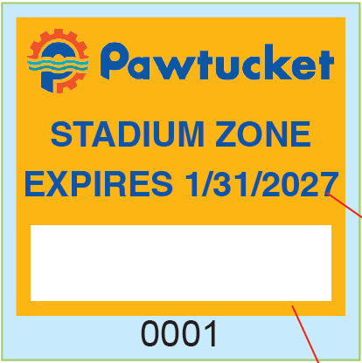
RESIDENT PARKING PERMITS:
  To apply residents must show a valid Rhode Island motor vehicle registration registered in the name and address of a person living within the Stadium Zone for each requested vehicle.
    One guest permit is allowed per residence.
    One temporary pass is allowed for residents who have not yet changed their address on their motor vehicle registration.
      A temporary pass is valid for 60 days.
    To obtain a temporary pass, residents must have a valid motor vehicle registration showing the name of the resident and one of the following: a copy of a Pawtucket tax bill, utility bill, bank statement, income tax return, pay stub, current deed or lease/rental agreement addressed in the name of the resident and to that residence

Slide 9
ENFORCEMENT/
SIGNAGE

Slide 10
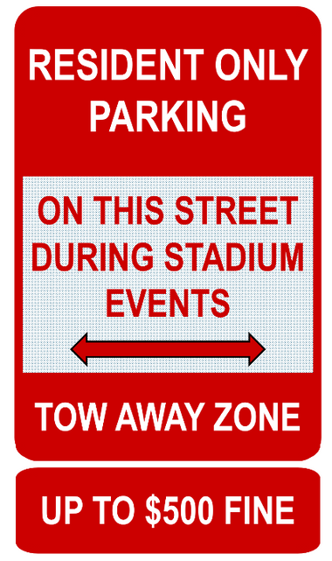
ELIGIBLE STREETS:
(1) East Avenue from Lyman Street to James Street.
(2) Lyman Street.
(3) Manning Street.
(4) Clyde Street from Cleveland Street to East Avenue.
(5) Rhodes Street.
(6) Harvey Street.
(7) Tower Street.
(8) James Street.
(9) Cleveland Street.
(10) Clifford Street.
(11) Pleasant Street from Cleveland Street to James Street.
(12) Fowler Avenue from Pleasant Street to Cleveland Street.
(13) Shoreham Court.
(14) Buffum Street.
(15) Bowles Court.
(16) Bensley Street.
(17) Merry Street.
(18) Jeffers Street.
(19) Tidewater Street.
(20) Winter Street.
(21) Spencer Street.
(22) Thornton Street.
(23) Taft Street from Tidewater Street to Bowles Court.

Slide 11
QUESTION &
ANSWERS

Slide 12

FEEDBACK SURVEY
FOR QUESTIONS OR TO APPLY FOR YOUR PERMIT ONLINE:
STADIUMZONE@PAWTUCKETRI.GOV
FOR THE INFORMATION SHARED IN THIS PRESENTATION: PAWTUCKETRI.GOV/STADIUM-PARKING-INFORMATION/

Slide 13
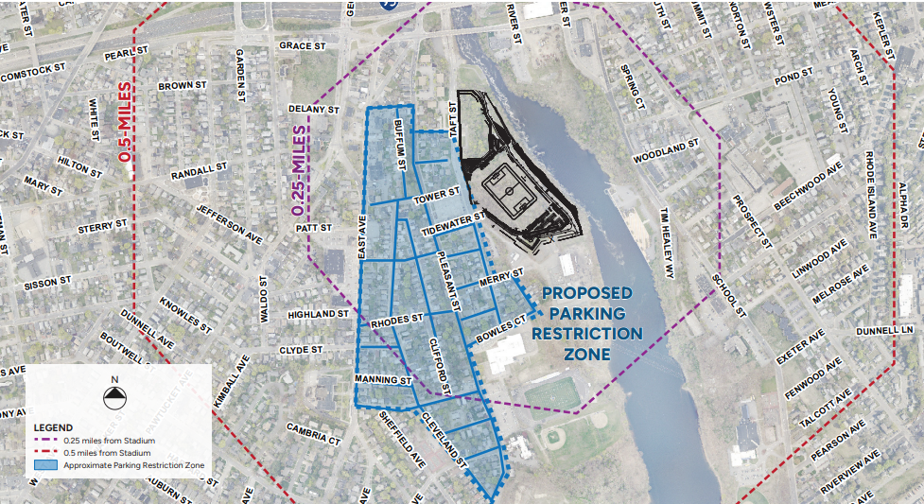

Slide 14
